Slide 1








Amul
TheTaste of India
Presented by
P.LAWRENCE
R.AMARESH

Slide 2

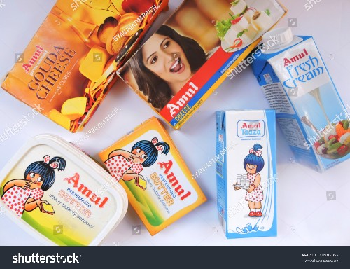
Introduction
Amul is an acronym (Anand Milk Union Limited) of the Indian cooperative society named Gujarat Milk Marketing Federation based in Anand, Gujarat. It is under the ownership of Gujarat Cooperative Milk Marketing Federation Limited, Department of Cooperation, Government of Gujarat. It is controlled by 3.6 million milk producers.

Slide 3


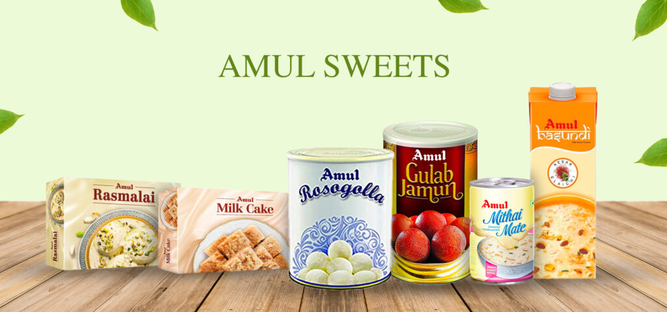
Trade name | Amul Coop
Type | Cooperative
Industry | Dairy
Founded | 14 December 1946; 76 years ago
Founder | Tribhuvandas Patel
Headquarters | Anand, Gujarat, India
Area served | Worldwide
Key people | Jayen Mehta (managing director)
Products | Milk products
Revenue | ₹52,000 crore (US$6.5 billion) (2022)
Owner | Dairy Producers of Gujarat
Number of employees | 1,000 (officers and employees) 3.6 million (milk producers)
Divisions | Banas Dairy Dudhsagar Dairy
Website | amul.com

Slide 4
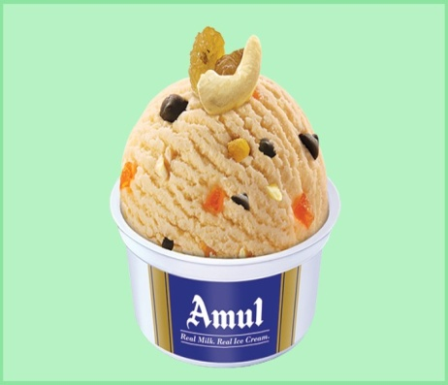

Amul’s digital marketing strategies have effectively utilized various online platforms to engage with their audience.
Digital marketing strategy used by amul
Through social media channels like Facebook, Instagram, and Twitter, Amul has created a strong online presence and interacted with consumers in a personalized and engaging manner.

Slide 5
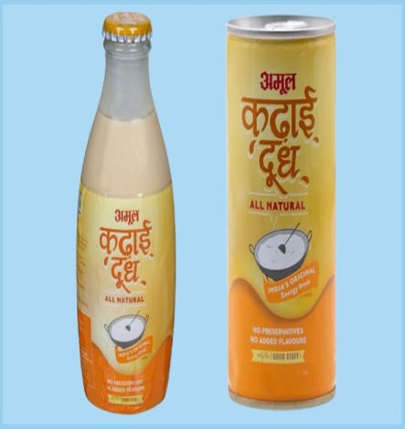
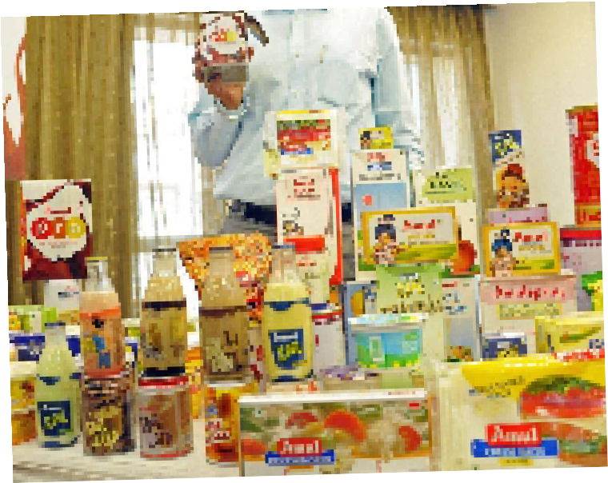
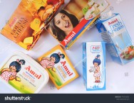
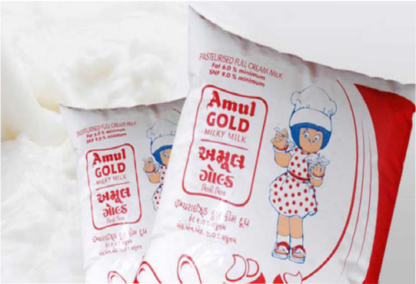
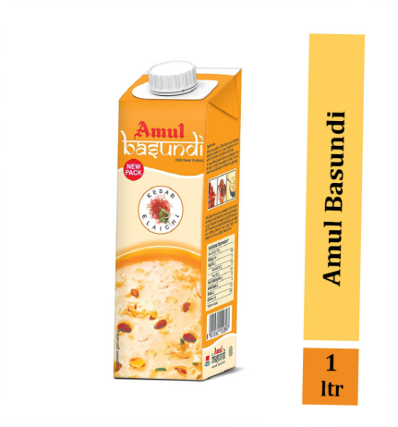
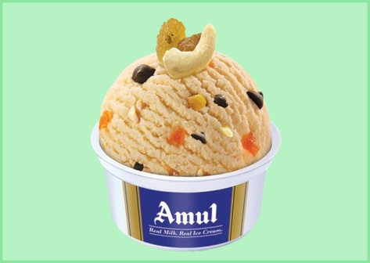
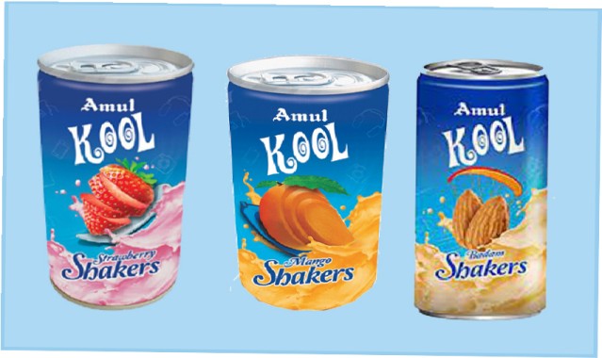
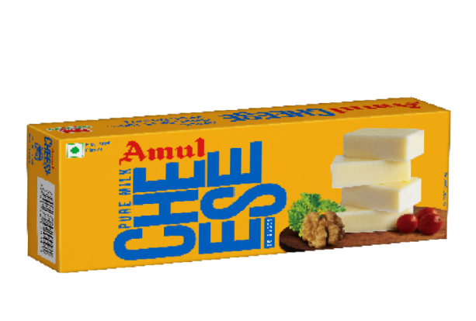
Brand products
Butter · Amul Milk .Bread Spreads · Cheese · Paneer · Dahi · Cheese Sauce · Beverage Range · Organic Products · Amul Protein Products · Ice Cream · Ghee e ...

Slide 6
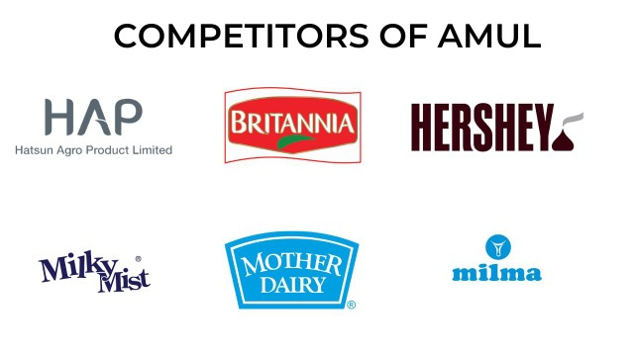
Brand competitor
The top competitors of Amul (GCMMF) include Akshayakalpa, Godrej Agrovet, Milky Mist, Dodla Dairy and Milk Mantra.britania, Nestle mother dairy, milkymist etc.Amul (GCMMF) has 273 active competitors. ranked by Tracxn score: Akshayakalpa - Tiptur based, 2010 founded, Series B company.

Slide 7
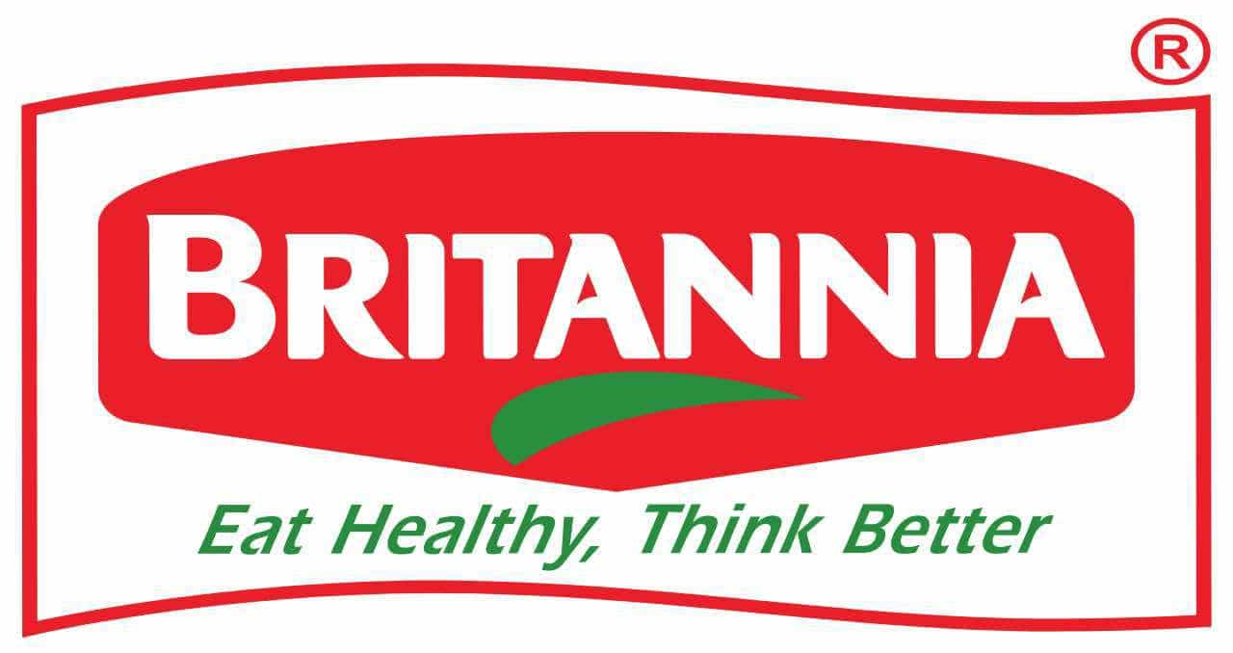
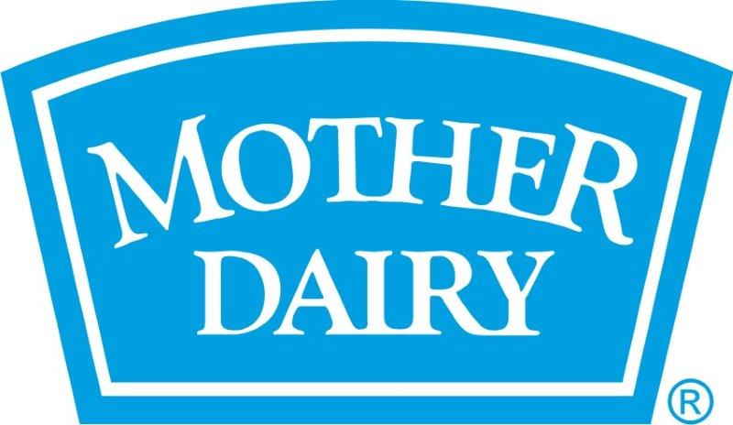

Marketing strategy of Britannia and social media campaigns are more focused on connecting taste, nutrition, and moments of life.
marketing strategy of Mother Dairy – a brand that not only nourishes India with wholesome dairy products but also uplifts rural communities through direct sourcing from village-level farmers.
Marketing Strategy of Hershey's analyzes the brand with the marketing mix framework which covers the 4Ps (Product, Price, Place, Promotion). These business strategies, based on Hershey's marketing mix, help the brand succeed in the market.

Slide 8

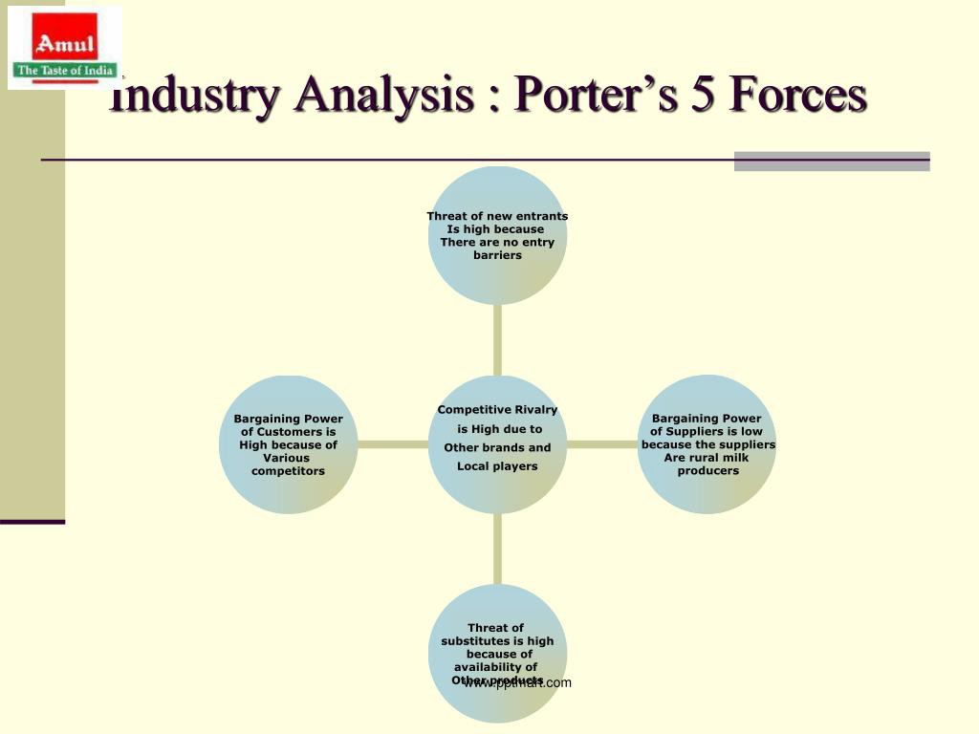

Porter ﬁve forces model

Slide 9
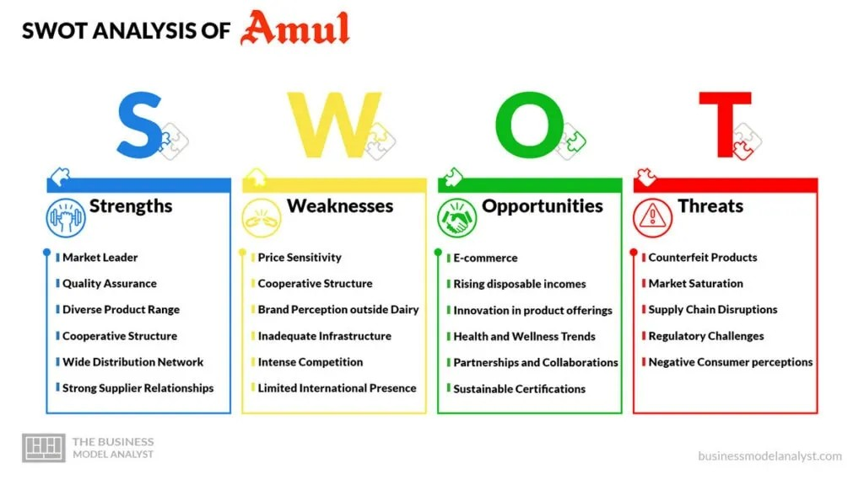
Amul SWOT analysis

Slide 10
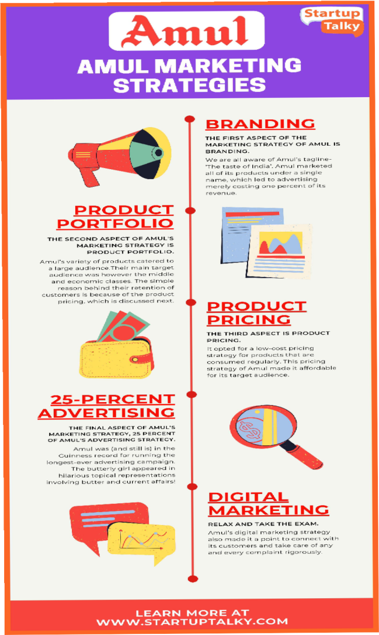
Search engine optimization for Amul
Amul always tried to provide their products at the best price. Its presence in every nook and corner has made it approachable in each house. They have not invested too much on Television advertisements. Rather they now prefer to use social media for their promotion and increase their presence. The brand actively uses two major social media platforms Facebook and Twitter.
Recently it has used great graphics and videos for the Rio Olympics 2016.

Slide 11
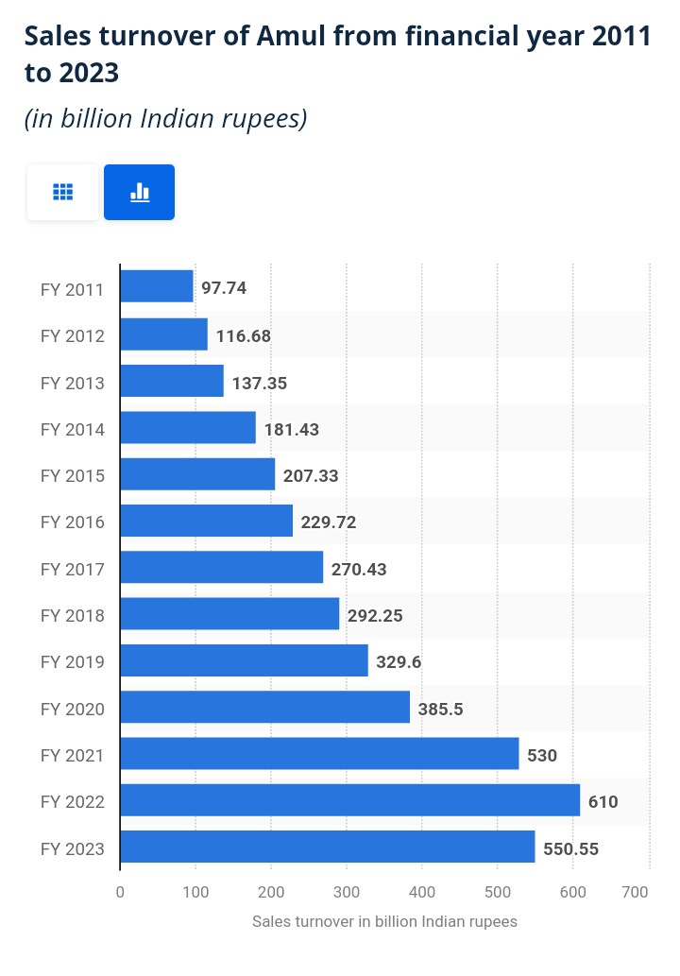
market status of brand
In ﬁnancial year 2023, Amul reported a sales turnover of over 550 billion Indian rupees. Anand Milk Union Limited (Amul) is one of the largest dairy companies in the world with an increasing growth rate since 2011.

Slide 12
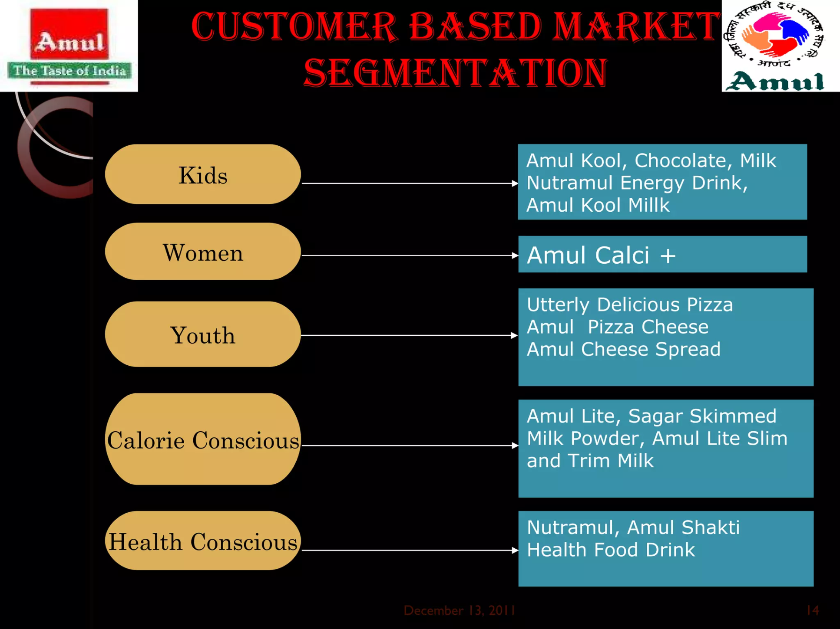
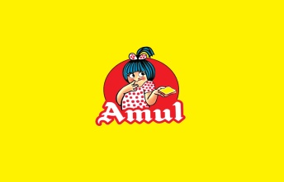

Slide 13

Brand curation strategies of amul
Iconic amul girl
Creative advertising
Quality dairy products
Wide product range
Strong distribution
Cooperative model
Social responsibility
innovation

Slide 14

.
s4

